Slide 1

SHOEZY
Find your perfect pair. Step up with Shoezy
Module: Web Application Development
Module Leader: Mr. Saravanapavan Nasiketha
Project Title: Shoezy – Online Shoe Store
Date : 17.09.2025
GROUP U

Slide 2

THE BRAND
Shoezy is a web-based e-commerce project focused on delivering stylish, affordable, and accessible footwear to a wide range of customers.

Slide 3

Introduction and Objectives
Develop an online business website, Shoezy, focused on footwear sales. Key goals include creating an easy-to-use site for customers and an efficient backend for administrators.

Slide 4


Website Planning and Design (UI/UX)
Design a clean, minimal interface emphasizing product visibility. Navigation includes Home, Men, Women, Kids, Sports, About, and Contact pages with clear call-to-action buttons like Shop Now.

Slide 5


Features and User Roles
Customer features include browsing, viewing product details, and contact options. Admin users can add, update, and delete products. The system includes user role management with different access levels such as Admin, Editor, and Customer.

Slide 6


Technical Implementation and Tools
The website is developed using PHP and MySQL for database management. Features include database operations like insert, update, delete, and select. Contributions are tracked via GitHub, and the site is fully responsive for desktop .

Slide 7

Database Design and Relationships
The database includes entities such as Users, Products, Categories, and Orders. Relationships define Admin managing Products and Users placing Orders. MySQL tables use attributes like product_id and user_id to maintain integrity and efficient data handling.

Slide 8
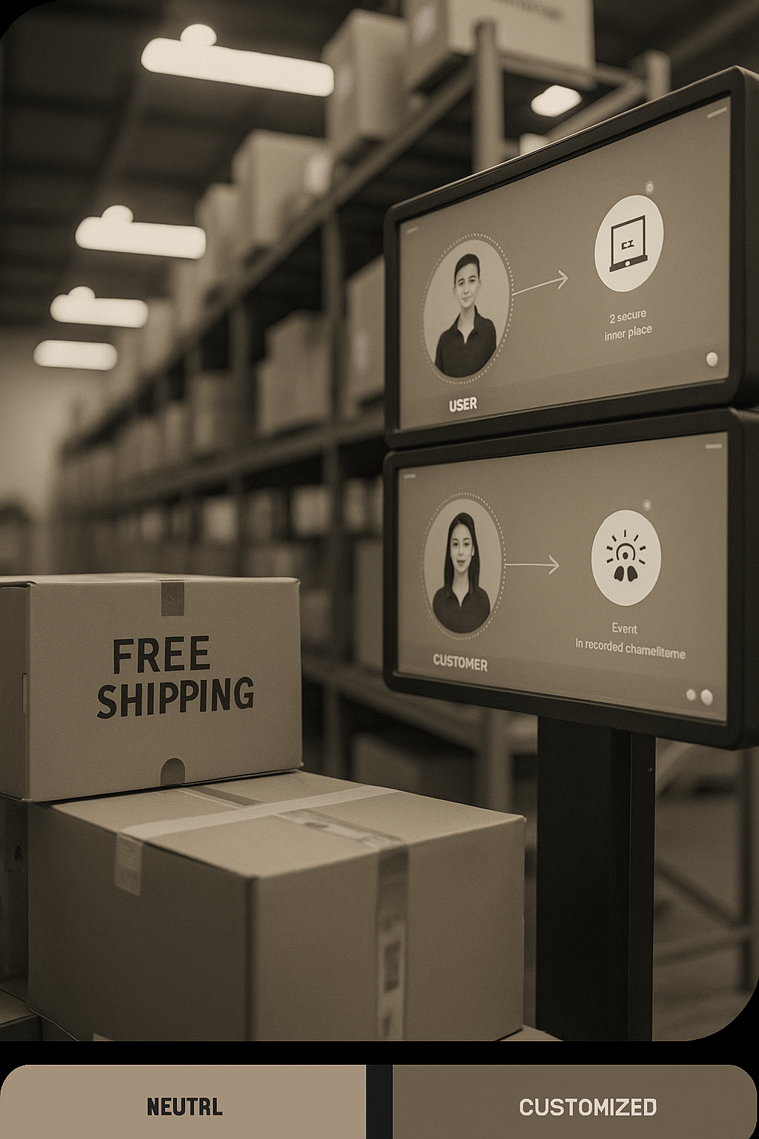
Benefits, Challenges, and Future Enhancements
Key benefits include free home delivery, secure payment options, and 24/7 online support. Challenges involved database integration and responsive design. Future plans include adding payment gateways, AI recommendations, and multi-language support.

Slide 9




Conclusions
The Shoezy project successfully created a comprehensive e-commerce platform with efficient admin control and user-friendly features. It meets current market needs and is scalable for future enhancements to improve customer experience and operational management.

Slide 10

THE TEAM
P.D.S.Kavindu-36527
H.K.P.K.Induwara-36888
R.M.D.O.Pathirana-36984
H.S.Y.Perera-36464
M.K.Ayesh-36622
H.K.Hemachandra-37075
T.P.T.Perera-36241
S.H.G.Sooriyaarachchi-36881
I.B.Dadigama-36515
A.T.Jansen-36417

Slide 11

Q & A

Slide 12

THANK YOU!

